Slide 1
Data Visualization & Interpretation
Febin.A.Vahab

Slide 2
Recap
Effective and Ineffective Visuals
FTE, Summer Learning programme, Arkansas Health Department Visual, John Murdoch Covid-19 Tracking Visual
Data Viz-Definition,Why do we visualise data?.
Visualisation as a discovery tool( Anscombe’s Quartet)
Visualisation Objectives

Slide 3
SESSION 2 -PLAN
Contact Sessions(#) | List of Topic Title | Text/Ref Book/external resource
2 | Exploratory vs. explanatory analysis Understanding the context for data presentations | T2 Ch1

Slide 4
Visualization Context
“Success in data visualization does not start with data visualization itself.”
-- Cole Knaflic
…understanding context sets solid foundation for data visualization creation

Slide 5
Understanding the Context
Exploratory Analysis
Explore data to become familiar with data
Dig through the data
Find trends and relationships w.r.t. specific goals
Explanatory Analysis
Explain outcomes or results of analysis
Tell a story with data

Slide 6
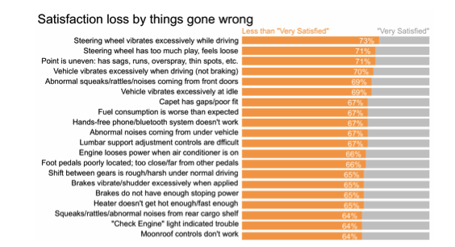
Example1
Car Manufacturer
Exploratory Analysis

Slide 7
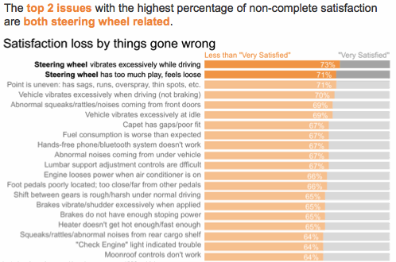
Example
Car Manufacturer
Explanatory Analysis

Slide 8
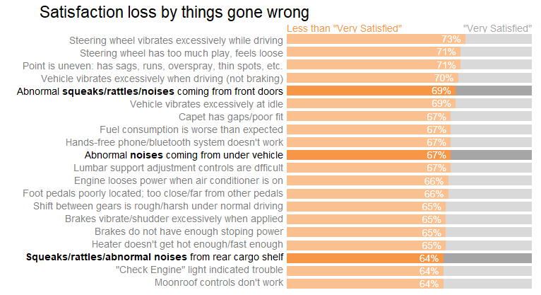
Example
Car Manufacturer
Explanatory Analysis

Slide 9
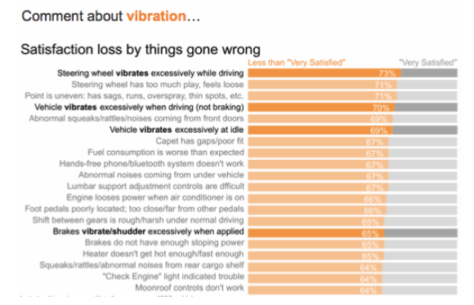
Example
Car Manufacturer
Explanatory Analysis

Slide 10
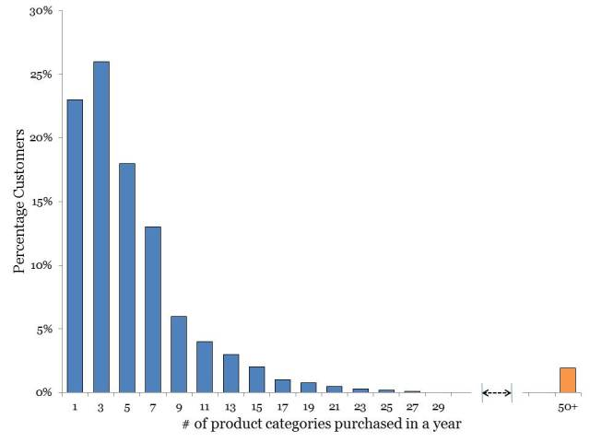
Example2
DresSMart Inc-Retail Case Study
Exploratory Analysis

Slide 11
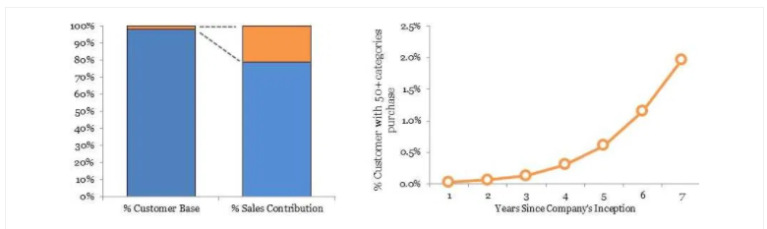
Example2
Retail Case Study
Small neighborhood retailers using DresSMart Inc as a wholesaler
Explanatory Analysis

Slide 12
Exploratory and Explanatory Analysis-Qn
With your data you need to show which districts in your region is not meeting its sales goals. Is this an example of exploratory or explanatory analysis?
Explanatory Analysis
As this is a specific question you need to answer and you already recognize the patterns and need to explain it.

Slide 13
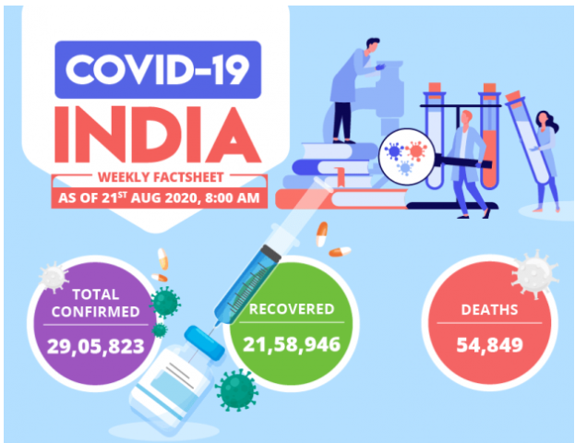
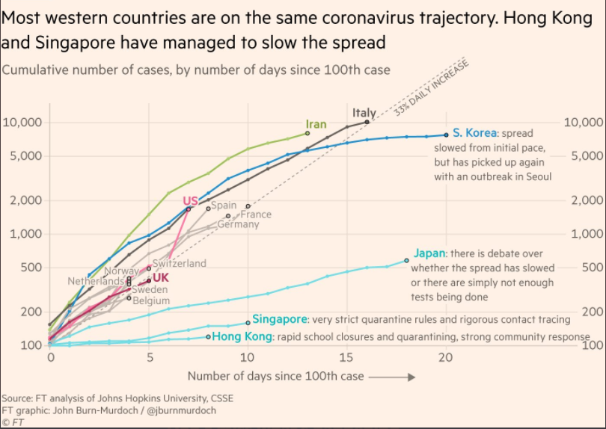
Exploratory and Explanatory Analysis

Slide 15
Exploratory and Explanatory Analysis
Explanatory Analysis
https://www.nytimes.com/interactive/2017/03/21/climate/how-americans-think-about-climate-change-in-six-maps.html

Slide 16
Visualization Context-Explanatory Analysis
Context includes :
Who
To whom you are communicating?
What
What do you want your audience to know or to do?
How
How can you use data to help make your point?

Slide 17

Identifying Audience
Who?
Who is audience? To whom you are communicating?
How they perceive you?
Help to find common ground that helps to convey your message

Slide 18
Identifying the Audience-WHO
You are the advertising media analyst who is made responsible for providing recommendation on media spend of product
Who : The marketing team that allocates funding for media advertisement for a product

Slide 19

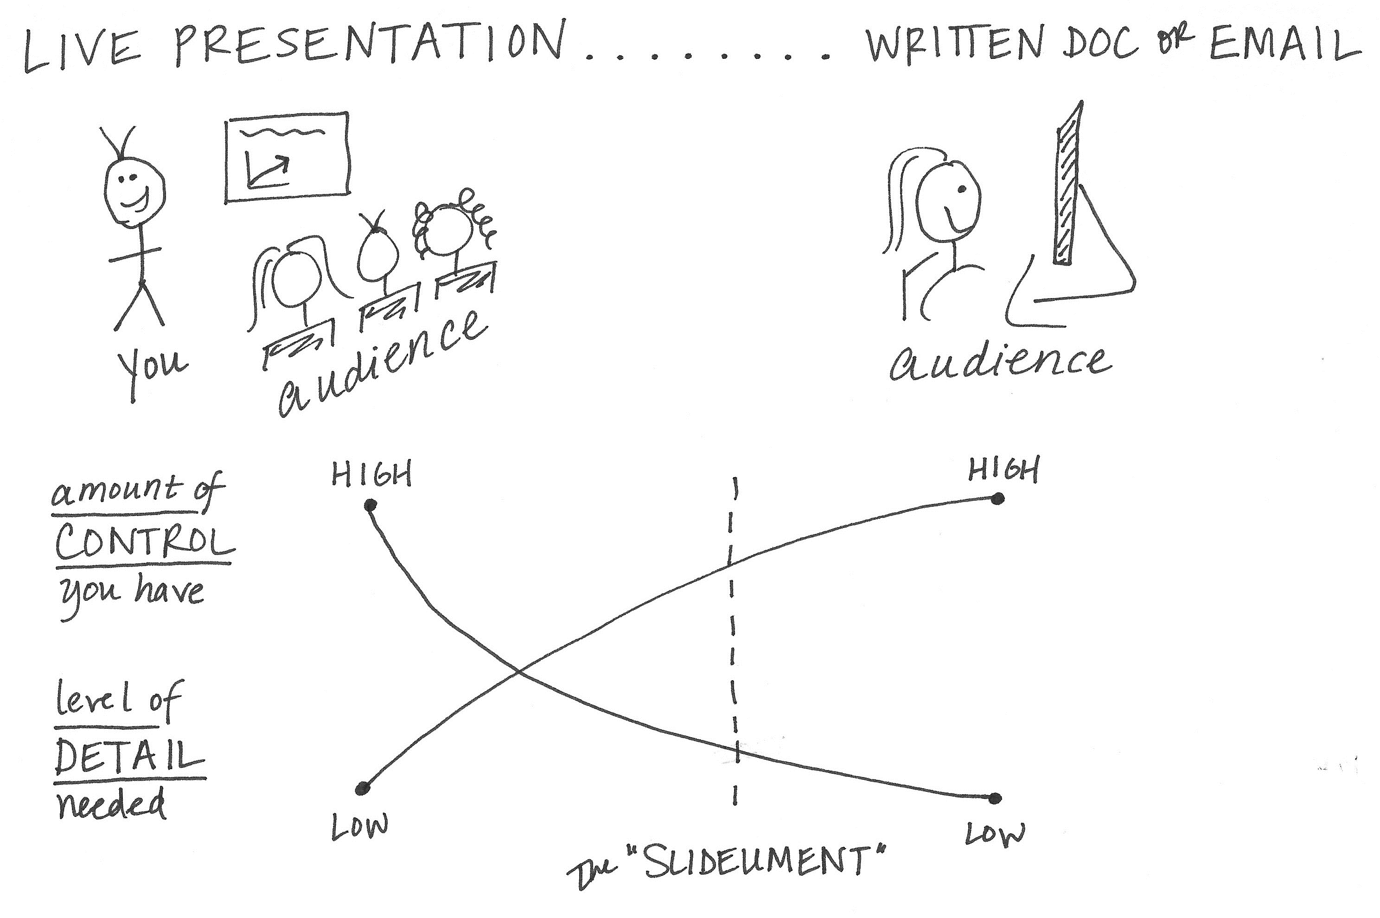
Know or Act
What do you want your audience to know or to do?
Action
Mechanism
Tone

Slide 20
Identifying the Audience-WHAT
You are the advertising media analyst who is made responsible for providing recommendation on media spend of product
Who : The marketing team that allocates funding for media advertisement for a product
What : The current advertising campaign went well on TV but find very limited success in print media

Slide 21

Data
How?
How can you use data to help make your point?
What data is available? Supporting evidence of the story

Slide 22
Identifying the Audience-WHAT
You are the advertising media analyst who is made responsible for providing recommendation on media spend of product
Who : The marketing team that allocates funding for media advertisement for a product
What : The current advertising campaign went well on TV but find very limited success in print media
How: Illustrate success with data available through analysis of spends and product revenues

Slide 23
3-minute Story
If you had only three minutes to tell your audience what they need to know, what would you say?

Slide 24
BIG IDEA
The Big Idea boils the so-what down even further: to a single sentence.
1. It must articulate your unique point of view;
2. It must convey what’s at stake; and
3. It must be a complete sentence.

Slide 25
BIG IDEA
The Big Idea boils the so-what down even further: to a single sentence.
1. It must articulate your unique point of view;
2. It must convey what’s at stake; and
3. It must be a complete sentence.

Slide 26
Case Study-1
Summer Learning Programme

Slide 27
Case Study 2
BITS Pilani DSE-Electives.
As a faculty co-ordinator of a well-known organisation, you have to take a decision on the elective to be offered to the students for second semester of their M.Tech Data Science program.
The available electives were
1. Artificial Intelligence
2. Data Visualisation
3. Systems for Data Analytics.
Identify the Visualisation Context.

Slide 28
Case study 3.
Clothing Retailer. Narrow down the audience
You work at a national clothing retailer. You’ve conducted a survey asking your customers and the customers of your competitors about various elements related to back-to-school shopping. You’ve analyzed the data. You’ve found there are some areas where your company is performing well, and also some other areas of opportunity. You’re nearing the point of communicating your findings.

Slide 29
Case study 3.
Clothing Retailer.
QUESTION 1: There are a lot of different groups of people (at your company and potentially beyond) who could be interested in this data. Who might care how your stores performed in the recent back-to-school shopping season? How many different audiences can you come up with who might be interested in the survey data you’ve analyzed?

Slide 30
Case study 3.
Clothing Retailer.
Senior leadership
Buyers
Merchandisers
Marketing
Store managers
Sales associates
Customer service people
Competitors
Customers

Slide 31
Case study 3.
Clothing Retailer.
QUESTION 2: You’ve analyzed the survey data and found that there are differences in service satisfaction reported by your customers across the various stores. Which potential audiences would care about this? List them.

Slide 32
Case study 3.
Clothing Retailer.
Senior leadership
Store managers
Sales associates
Customer service people

Slide 33
Case study 3.
Clothing Retailer.
QUESTION 3: You’ve found there are differences in satisfaction across stores. Your analysis reveals items related to sales associates as the main driver of dissatisfaction. You’ve looked into several potential courses of action to address this and determined that you’d like to recommend rolling out sales associate training as a way to improve and bring consistency to service levels across your stores. Now who might your audience be? Who cares about this data?

Slide 34
Case study 3.
Clothing Retailer.
Senior leadership
HR
Finance
Store managers
Sales associates
Customer service people

Slide 35
Case study 3.
Clothing Retailer.
Construct the Big IDEA assuming the head of retail as your audience
WHO?:
WHAT?:
HOW?:

Slide 36
Case study 3.
Clothing Retailer.
Construct the Big IDEA assuming the head of retail as your audience
WHO?: The head of retail
WHAT?:Who do they care about?
Having a highly profitable back-to-school shopping season
Making Customers happy because happier customers spend more
Beating the competition

Slide 37
Case study 3.
Clothing Retailer.
Construct the Big IDEA assuming the head of retail as your audience
WHAT?:What action your audience need to take?
Agree that training is the right way to deal with inconsistent service levels and approve the resources it will take to make that happen(cost, time,people)
HOW???

Slide 38
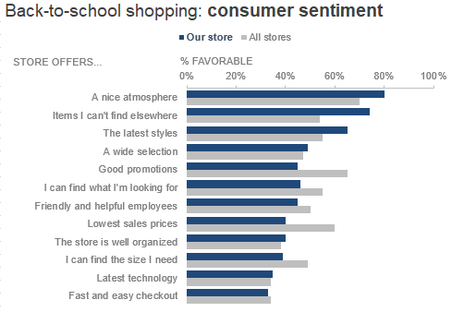
Exploratory Analysis-Result

Slide 39
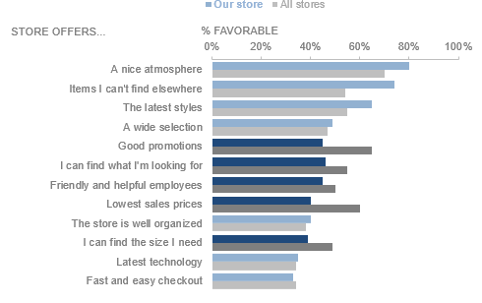
Back-to-school shopping: consumer sentiment
Notes:
7.8m

Slide 40
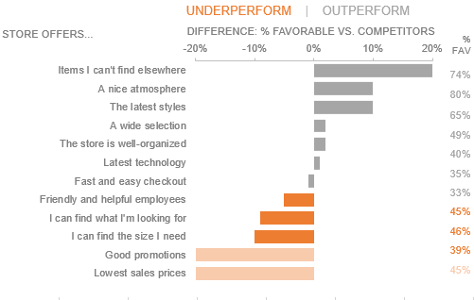
Back-to-school shopping: consumer sentiment
Notes:
7.8m

Slide 41
Case study 3.
Clothing Retailer.
Construct the Big IDEA assuming the head of retail as your audience
BIG IDEA:
Let us invest in sales associate training to improve the in-store shopping experience and make the upcoming back-to-school season the best revenue generating one yet!!!

Slide 42
Summary

Slide 43
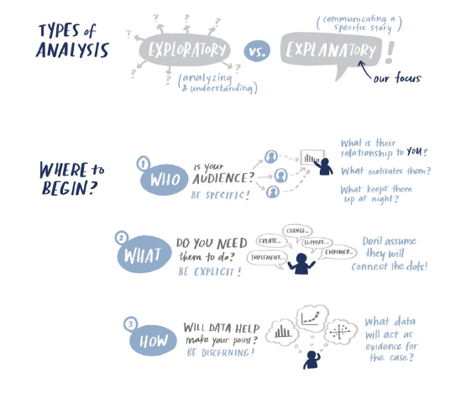

Slide 44
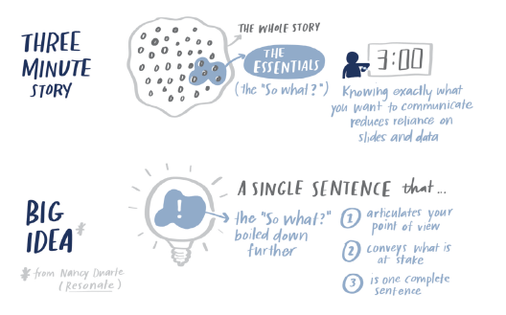

Slide 45
HW-Discuss in Canvas
People Analyst
Imagine you work as a People Analyst (a data analyst within the Human Resources, or HR, function) at a medium-sized company. A new head of HR has just joined the organization (she is now your boss’s boss). You’ve been asked to pull together an overview with data to help the freshly hired head of HR get up to speed with the different parts of the business from a people standpoint. This will include things like interview and hiring metrics, a headcount review across different parts of the organization, and attrition data (how many are leaving and why they are leaving). Some of your colleagues in other groups within HR have already had meet-and greets with the new leader and given their respective synopses. Your direct manager recently had lunch with the new head of HR.
List three things you could do to understand your audience, what she cares about, and how to best address her needs

Slide 46
Objectives of EDA
Discover Patterns
Spot Anomalies
Frame Hypothesis
Check Assumptions

Slide 47
Steps of EDA: (Not exhaustive)
Feature identification/Identification of data types
Handling missing/Null values
Outlier / Anomalies
Univariate analysis
Bivariate analysis
Multi variate analysis
Variable transformation
Feature Extraction
Dimensionality reduction

Slide 48
Next Session
Choosing an Effective Visual
Gestalt principles of Visual Perception

Slide 49

References
Knaflic, Cole. Storytelling With Data: A Data Visualization Guide for Business Professionals, Wiley, 2015
Chapter 1 : The importance of context
Chapter 3 : Clutter is your enemy

Slide 50
Interesting Reads
https://eazybi.com/blog/data_visualization_and_chart_types/
https://blog.hubspot.com/marketing/types-of-graphs-for-data-visualization#sm.000vodl7ch6rf7e112a2q13r9cno0
Why do we visualize quantitative data? https://www.perceptualedge.com/blog/?p=1897
http://www.storytellingwithdata.com/blog/2019/5/23/visualizing-artisanal-data
https://www.tableau.com/learn/articles/data-visualization
https://www.tableau.com/sites/default/files/media/designing-great-visualizations.pdf

Slide 51
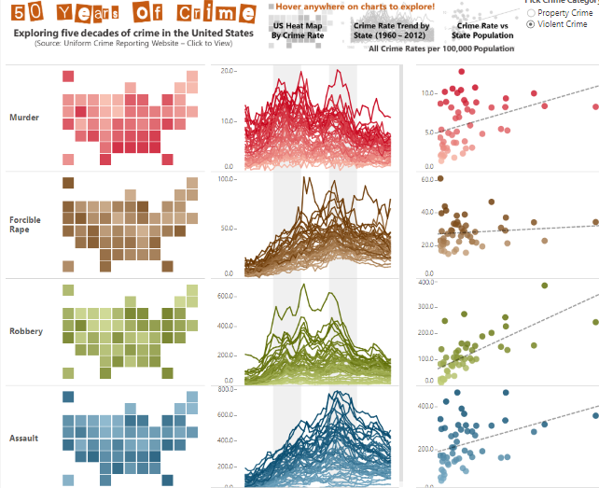
What is Data Visualisation?
Link

Slide 52
Thank You!

